Slide 1

Frontiers of Network Science
Fall 2023
Class 10: Evolving Networks
(Chapter 6 in Textbook)
based on slides by
Albert-László Barabási
and Roberta Sinatra
Boleslaw Szymanski
www.BarabasiLab.com

Slide 2
Fitness Model
Network Science: Evolving Network Models

Slide 3
Fitness Model: Can Latecomers Make It?
SF model: k(t)~t ^{½} (first mover advantage)
Fitness model: fitness (η ) k(η,t)~t^{β(η)}
β(η) =η/C
Degree (k)
time
Bianconi & Barabási, Physical Review Letters 2001; Europhys. Lett. 2001.

Slide 4
Section 5.3

Slide 5
Section 6
Absence of growth and preferential attachment

Slide 6
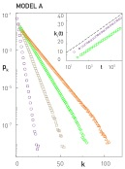
MODEL A
growth preferential attachment
Π(k_{i}) : uniform

Slide 7
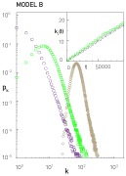
MODEL B
growth preferential attachment
p_{k} : power law (initially) →
→ Gaussian → Fully Connected

Slide 8
Do we need both growth and preferential attachment?
YEP
Network Science: Evolving Network Models

Slide 9


Regular network
EMPIRICAL DATA FOR REAL NETWORKS
Pathlenght
Clustering
Degree Distr.
P(k) ~ k^{-γ}
P(k)=δ(k-k_{d})
Erdos-
Renyi
Watts-
Strogatz
Exponential
Barabasi-Albert
P(k) ~ k^{-γ}
Network Science: Evolving Network Models
Notes:
As a universal feature, they do well in clustering and the path lenghts. However, they all fail in the degree distribution. Hence we need models the fix that problem. As will see, this is not a trivial feature– many properties of real networks are determined primarily by the degree distribution.

Slide 10
Section 9
The origins of preferential attachment
Notes:
Given the important role preferential attachment plays in the evolution of real networks, we must ask: where does preferential attachment come from? Specifically,
Why does depend on ?
Why is the dependence of linear in k ?
There are two philosophically different takes on these questions. The first approach views preferential attachment as an interplay between random events and some structural network property. These mechanisms do not require global knowledge of the network. Hence we will call them local or random mechanisms. The second approach assumes that the addition of each new node or link is preceeded by a cost-benefit analysis, balancing various needs with the available resources. This assumes familiarity with the whole network and relies on optimization principles, prompting us to call them global or optimized mechanisms. The purpose of this section is to discuss these two approaches.

Slide 11
Section 9 Link selection model
Link selection model -- perhaps the simplest example of a local or random mechanism capable of generating preferential attachment.
Growth: at each time step we add a new node to the network.
Link selection: we select a link at random and connect the new node to one of nodes at the two ends of the selected link.
To show that this simple mechanism generates linear preferential attachment, we write the probability that the node
at the end of a randomly chosen link has degree k as

Slide 12
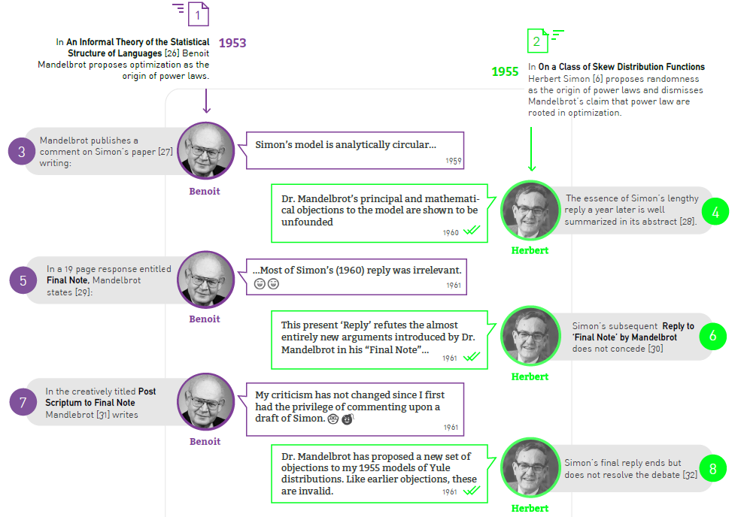
Section 9 Originators of preferential attachments
Notes:
Given the important role preferential attachment plays in the evolution of real networks, we must ask: where does preferential attachment come from? Specifically,
Why does depend on ?
Why is the dependence of linear in k ?
There are two philosophically different takes on these questions. The first approach views preferential attachment as an interplay between random events and some structural network property. These mechanisms do not require global knowledge of the network. Hence we will call them local or random mechanisms. The second approach assumes that the addition of each new node or link is preceeded by a cost-benefit analysis, balancing various needs with the available resources. This assumes familiarity with the whole network and relies on optimization principles, prompting us to call them global or optimized mechanisms. The purpose of this section is to discuss these two approaches.

Slide 13
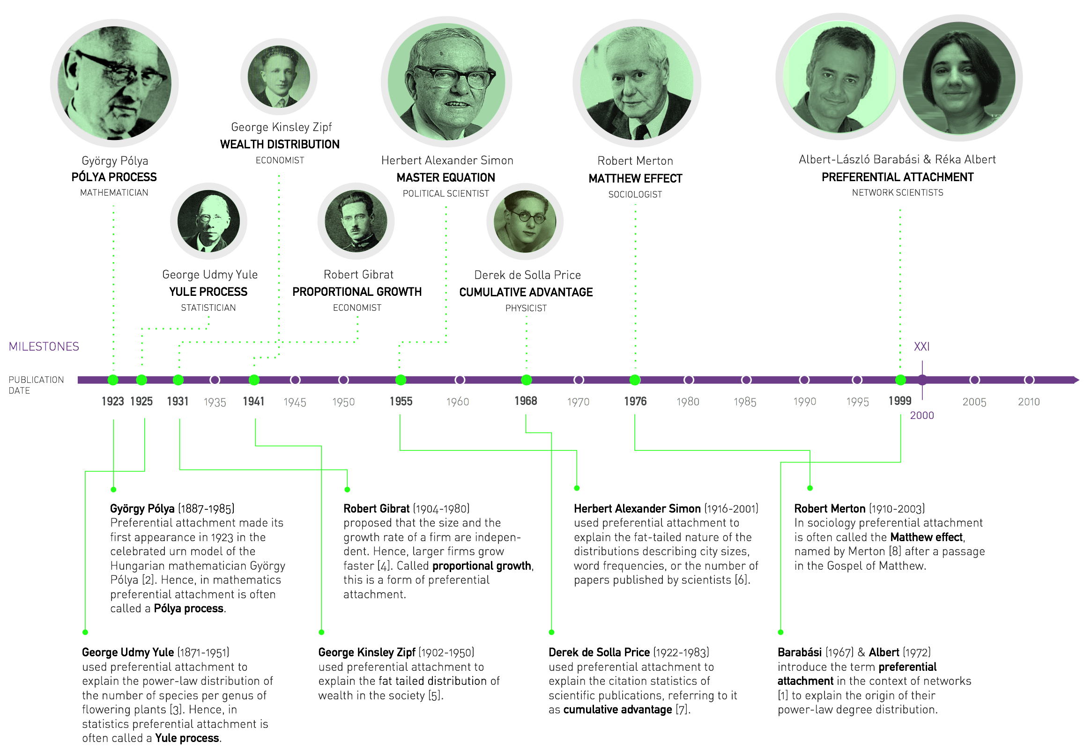
Notes:
The discovery of the Barabási-Albert model is recounted in Linked [9], describing a workstop in Porto, Portugal, attended by the first author of the model: “During the summer of 1999 very few people were thinking about networks, and there were no talks on the subject during this workshop. But networks were very much on my mind. I could not help carrying with me on the trip our unresolved questions: Why hubs? Why power-laws? […] Before I left for Europe, Réka Albert and I agreed that she would analyze these networks. On June 14, a week after my departure, I received a long email from her detailing some ongoing activities. At the end of the message there was a sentence added like an afterthought: “I looked at the connectivity distribution too, and in almost all systems (IBM, actors, power grid), the tail of the distribution follows a power law.” Réka’s email suddenly made it clear that the Web was by no means special. I found myself sitting in the conference hall paying no attention to the talks, thinking about the implications of this finding. If two networks as different as the Web and the Hollywood acting community both display power-law degree distribution, then some universal law or mechanism must be responsible. If such a law existed, it could potentially apply to all networks. During the first break between talks I decided to withdraw to the quiet of the seminary where we were housed during the workshop. I did not get far, however. During the fifteen-minute walk back to my room a potential explanation occurred to me, one so simple and straightforward that I doubted it could be right. I immediately returned to the university to fax Réka, asking her to verify the idea using the computer. A few hours later she emailed me the answer. To my great astonishment, the idea worked.” The two images above reproduce the fax sent on June 14, 1999 from Porto, describing the algorithm that we call today the Barabási-Albert model.

Slide 14
MECHANISMS RESPONSIBLE FOR PREFERENTIAL ATTACHMENT
Copying mechanism
  directed network
    select a node and an edge of this node
    attach to the endpoint of this edge
Walking on a network
  directed network
  the new node connects to a node, then to every
  first, second, … neighbor of this node
Attaching to edges
    select an edge
    attach to both endpoints of this edge
Node duplication
  duplicate a node with all its edges
  randomly prune edges of new node
Network Science: Evolving Network Models
Notes:
Growth is obvius– network with a million nodes could not emerge with a million nodes right away– it had to grow naturally. But it is not obvious at all where does preferential attachment come from.

Slide 15
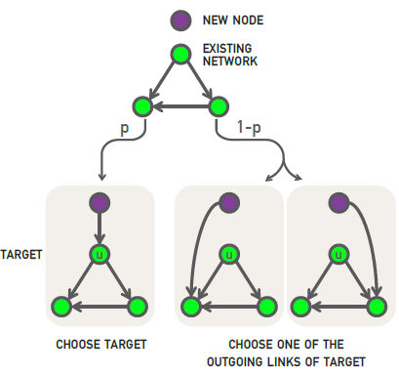
Section 9 Copying model
(a) Random Connection: with probability p the new node links to u.
(b) Copying: with probability p we randomly choose an outgoing link of node u and connect the new node to the selected link's target. Hence the new node “copies” one of the links of an earlier node
(a) the probability of selecting a node is 1/N.
(b) is equivalent with selecting a node linked to a randomly selected link. The probability of selecting a degree-k node through the copying process of step (b) is k/2L for undirected networks.
The likelihood that the new node will connect to a degree-k node follows preferential attachment
Social networks: Copy your friend’s friends.
Citation Networks: Copy references from papers we read.
Protein interaction networks: gene duplication,
Notes:
When building a new webpage, authors tend to borrow links from webpages covering similar topics, a process captured by the copying model [17, 18]. In the model in each time step a new node with a single link is added to the network. To choose the target node we randomly select a node u and follow a two-step procedure:

Slide 16
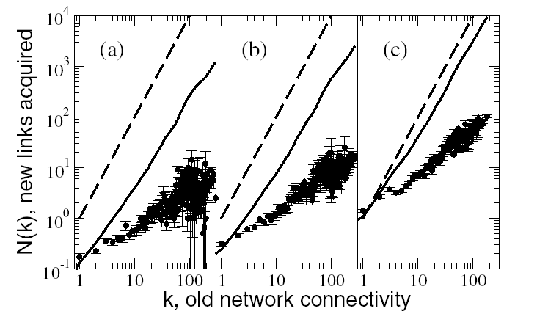
Preferential Attachment!
For given Δt: Δk ∝ Π(k)
k vs. Δk : linear increase in the # of links
S. Cerevisiae PIN: proteins classified into 4 age groups
Eisenberg E, Levanon EY, Phys. Rev. Lett. 2003.

Slide 17
SUMMARY: PROPERTIES OF THE BA MODEL
Nr. of nodes:
Nr. of links:
Average degree:
Degree dynamics
Degree distribution:
Average Path Length:
Clustering Coefficient:
β: dynamical exponent
γ: degree exponent
The network grows, but the degree distribution is stationary.
Network Science: Evolving Network Models

Slide 18
DEGREE EXPONENTS
γ^{collab}
γ^{metab}
γ^{intern}
γ^{synonyms}
γ^{w}_{in}
γ^{w}_{out}
γ^{actor}
γ^{cita}
γ^{sex}
γ=1
γ=2
γ=3
<k²> diverges
<k²> finite
BA model
Can we change the degree exponent?
Network Science: Evolving Network Models

Slide 19
Section 9 Optimization model for connecting new router
h_{j} denotes the distance of node j to the central node h₀
d_{jj} denotes the bandwidth between nodes i, j
δ denotes the ratio of cost of cable to delay
Question: where to place a new router ?
Notes:
A longstanding assumption of economics is that humans make rational decisions, balancing cost against benefits. In other words, each individual aims to maximize its personal advantage. This is the starting point of rational choice theory in economics [21] and it is a hypothesis central to modern political science, sociology and philosophy. As we show below, such rational decisions can lead to preferential attachment [22, 23, 24].
Consider the Internet, whose nodes are routers connected via cables. Establishing a new Internet connection between two routers requires us to lay down a new cable between them. As this is costly, each new link is preceded by a careful cost-benefit analysis. Each new router (node) will choose its link to balance access to good network performance (i.e. proper bandwith) with the cost of laying down a new cable (i.e. physical distance). This can be a conflicting desire, as the closest node may not offer the best network performance.

Slide 20
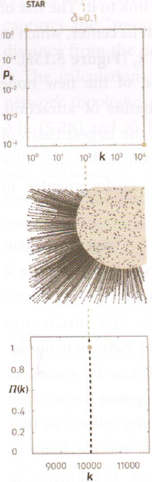
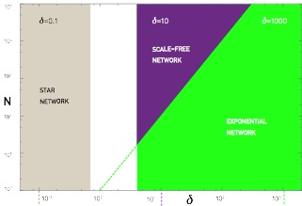
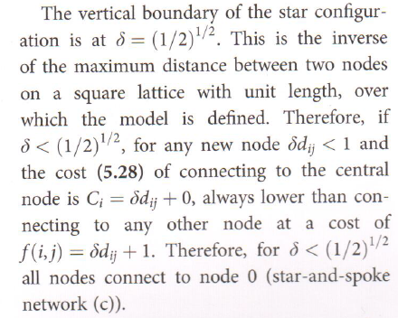
Section 9 Optimization model
Star Network

Slide 21
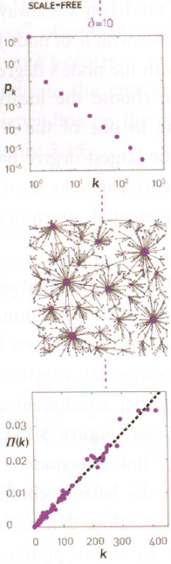
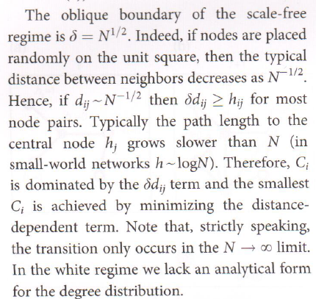
Section 9 Optimization model
Scale-Free Network

Slide 22
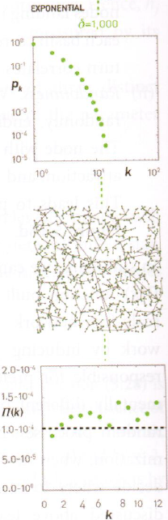
Section 9 Optimization model
Exponential Networks

Slide 23
Section 10
Diameter and clustering coefficient

Slide 24
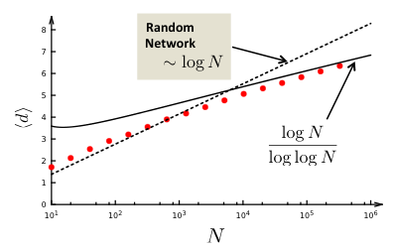
Section 10 Diameter
Bollobas, Riordan, 2002

Slide 25
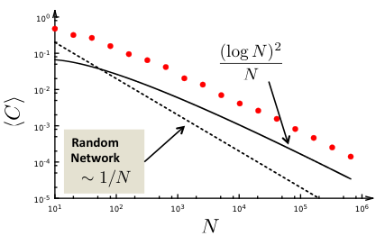
Section 10 Clustering coefficient
Reminder: for a random graph we have:
What is the functional form of C(N)?
Konstantin Klemm, Victor M. Eguiluz,
Growing scale-free networks with small-world behavior,
Phys. Rev. E 65, 057102 (2002), cond-mat/0107607

Slide 26
CLUSTERING COEFFICIENT OF THE BA MODEL
Nr(Δ)
1
2
Denote the probability to have a link between node i and j with P(i,j)
The probability that three nodes i,j,l form a triangle is P(i,j)P(i,l)P(j,l)
The expected number of triangles in which a node l with degree k_{l} participates is thus:
(Δ)
We need to calculate P(i,j).
Network Science: Evolving Network Models

Slide 27
CLUSTERING COEFFICIENT OF THE BA MODEL
Calculate P(i,j).
Node j arrives at time t_{j}=j and the probability that it will link to node i with degree k_{i} already in the network is determined by preferential attachment:
Where we used that the arrival time of node j is t_{j}=j and the arrival time of node is t_{i}=i
(Δ) =
Which is the degree of node l at current time, at time t=N
Let us approximate:
There is a factor of two difference... Where does it come from?
Network Science: Evolving Network Models

